Slide 1

SQL Data Analysis Project — Music Store Database
Analyzing customer behavior, sales performance, and music preferences using SQL
Made by –Nandini sharma
Tool used – mysql workbench

Slide 2
Project Overview
Content:
The project analyzes data from a music store database consisting of customers, invoices, artists, albums, tracks, and genres.
The goal is to generate meaningful business insights using SQL queries.
The analysis includes basic, intermediate, and advanced level queries.
Tools used: MySQL Workbench, PowerPoint

Slide 3
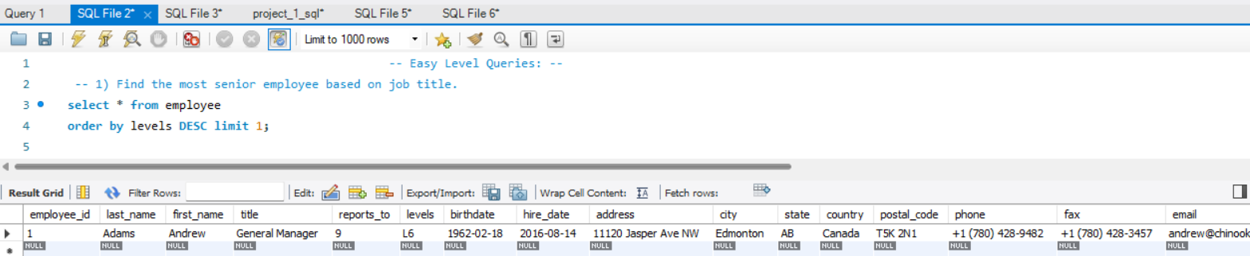
SQL Queries — Basic Level question -1)

Slide 4
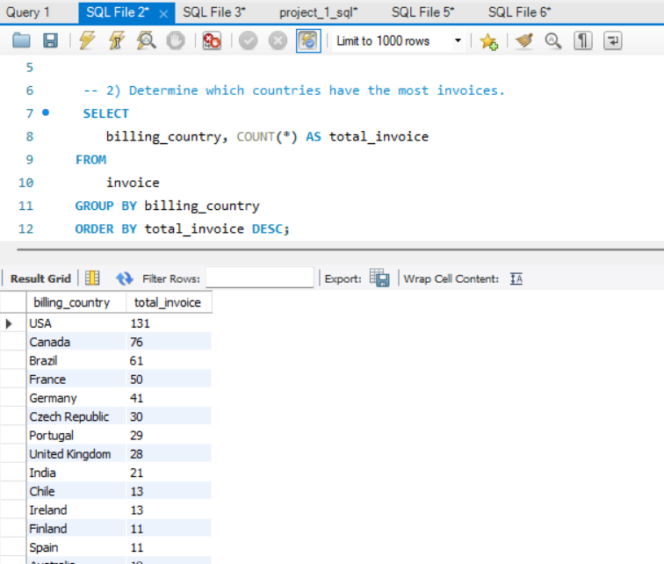
question -2)
Purpose:
Determines which city generated the highest total sales.
Logic:
Uses SUM(total) to calculate the total invoice amount per city.
Orders results by total sales and selects the top one.
Business Insight:
Helps the company identify the most profitable city — ideal for marketing events or store expansion.

Slide 5
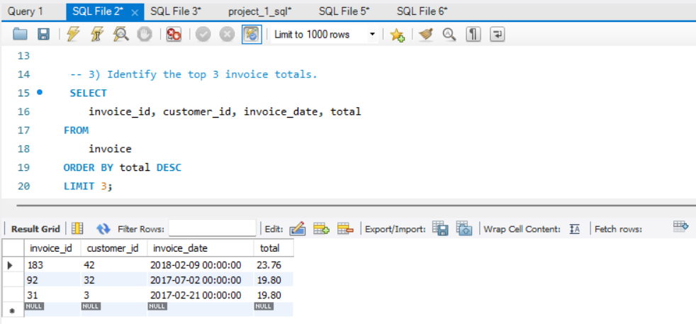
Question -3)

Slide 6
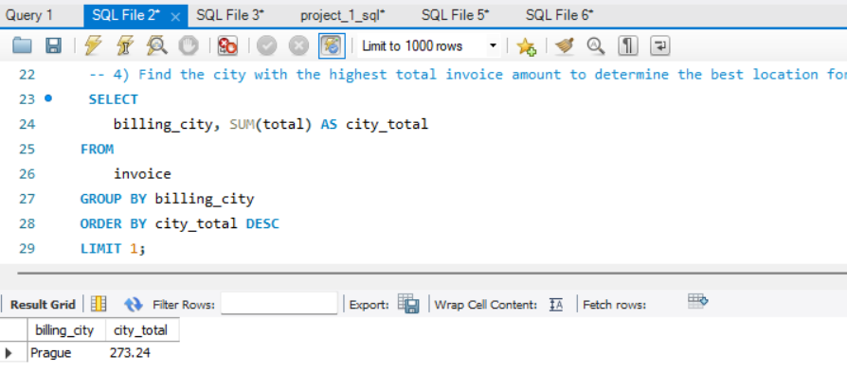
Question -4)

Slide 7
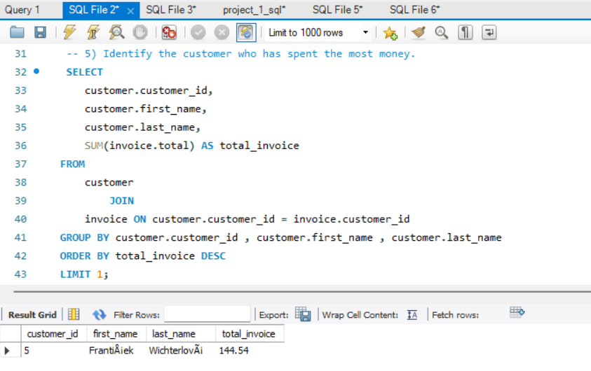
Question-5)
Purpose: Finds the customer with the highest overall spending. Logic: Sums invoice totals per customer and orders by total spent in descending order.

Slide 8
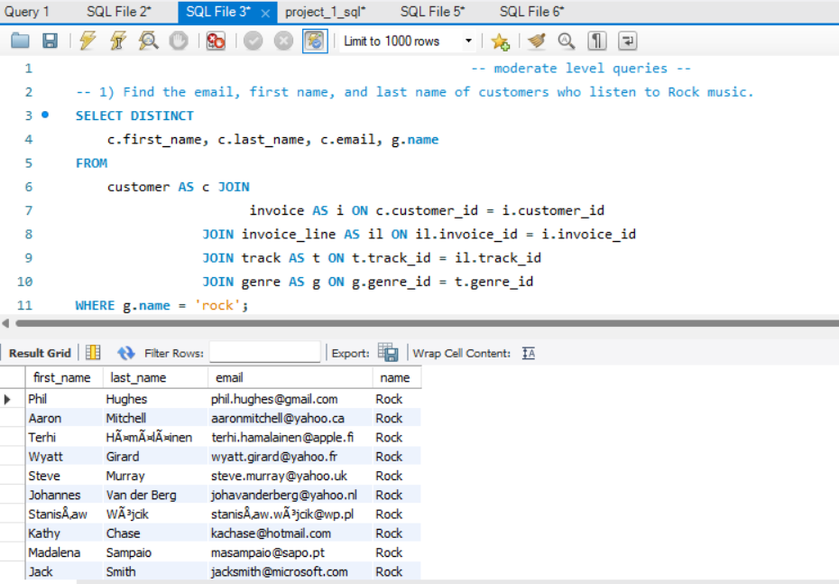
Moderate level question-1)

Slide 9
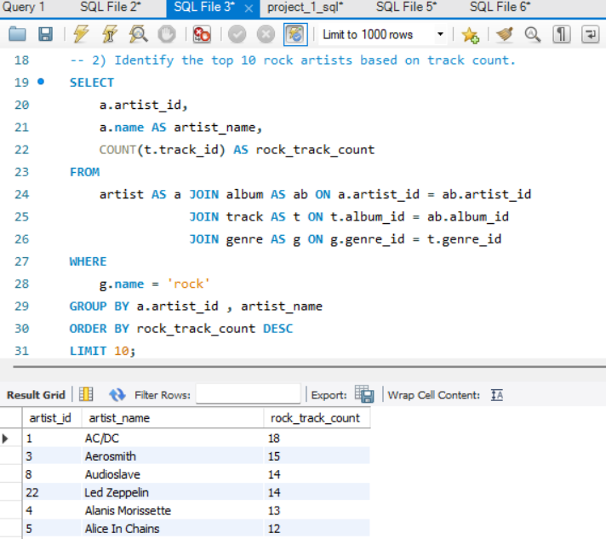
Question-2)
Purpose: Lists the top 10 artists who have the most rock tracks.
Logic: Filters tracks by genre = 'Rock', groups by artist, counts tracks, and sorts by count.

Slide 10
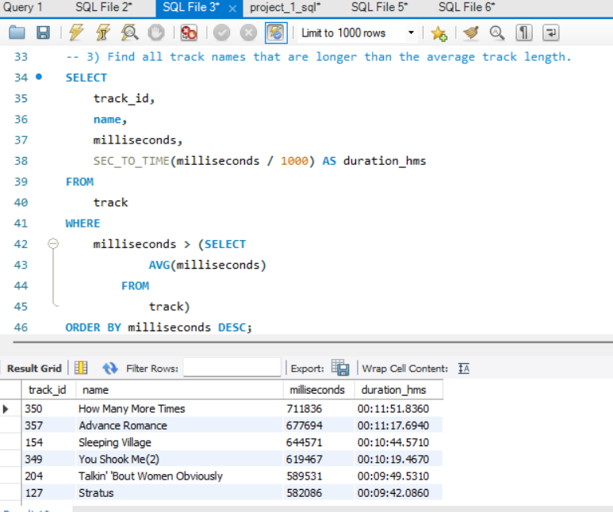
Question-3)
Purpose: Displays tracks whose duration exceeds the average length. Logic: Compares each track’s milliseconds with the average using a subquery or CTE.

Slide 11
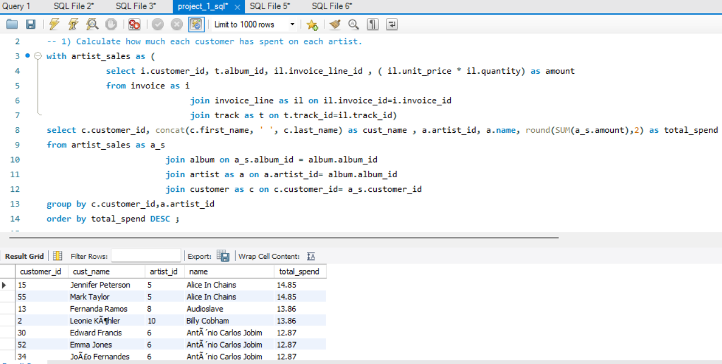
Advance level queries question -1)
Purpose: Shows how much money each customer spent on different artists. Logic: Joins invoice, track, album, and artist tables; sums up unit_price × quantity per customer and artist.

Slide 12
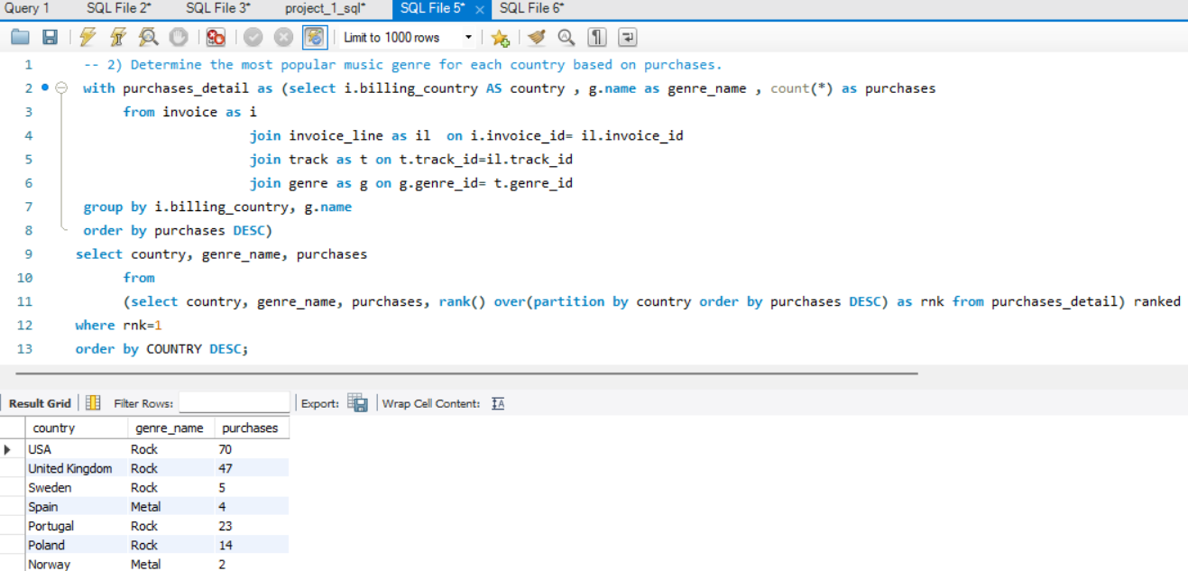
Question-2)

Slide 13
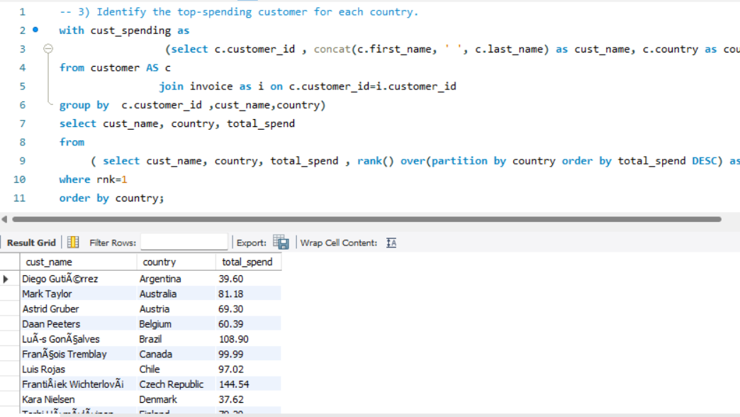
Question-3)

Slide 14

Findings & Insights
Rock is the most popular genre in most countries.
Top-spending customers can be targeted for loyalty programs.
Cities with highest total sales are ideal for promotional events.
Certain artists drive more sales — useful for strategic partnerships.

Slide 15

Conclusion
Successfully used SQL to explore and analyze a real-world relational database.
Applied joins, grouping, subqueries, CTEs, and ranking functions.
Gained valuable customer and sales insights for decision-making.

Slide 16

THANK YOU
nandinisharma@email.com 8287583087

